Slide 1
Gantt chart
File created on: 2021/3/29 17:07:23

Slide 2
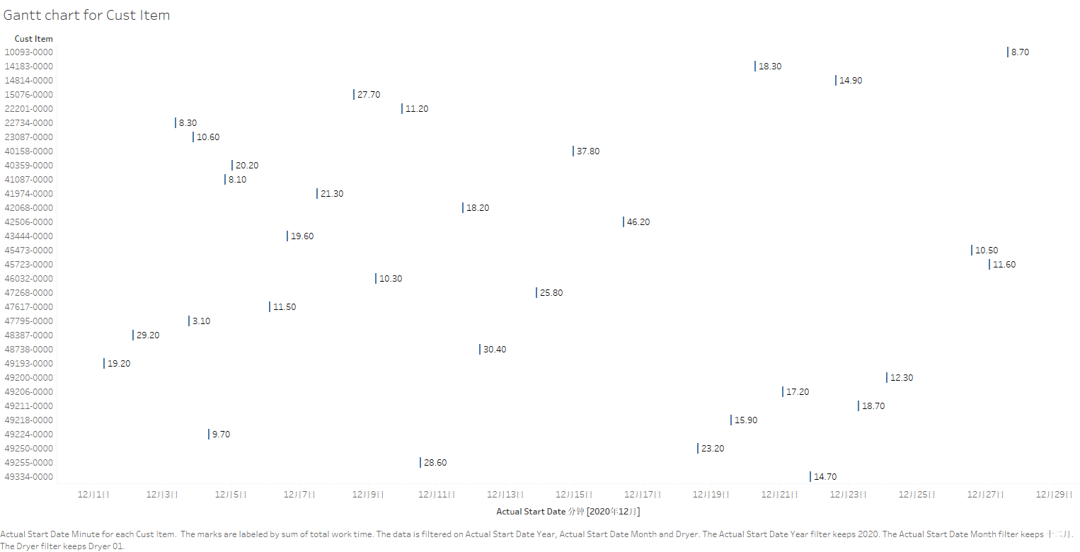

Slide 3
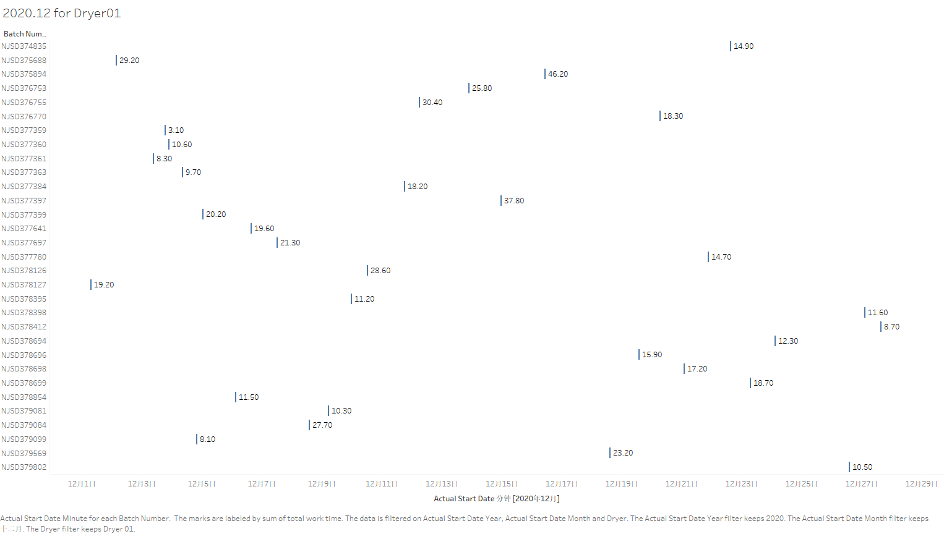

Slide 4
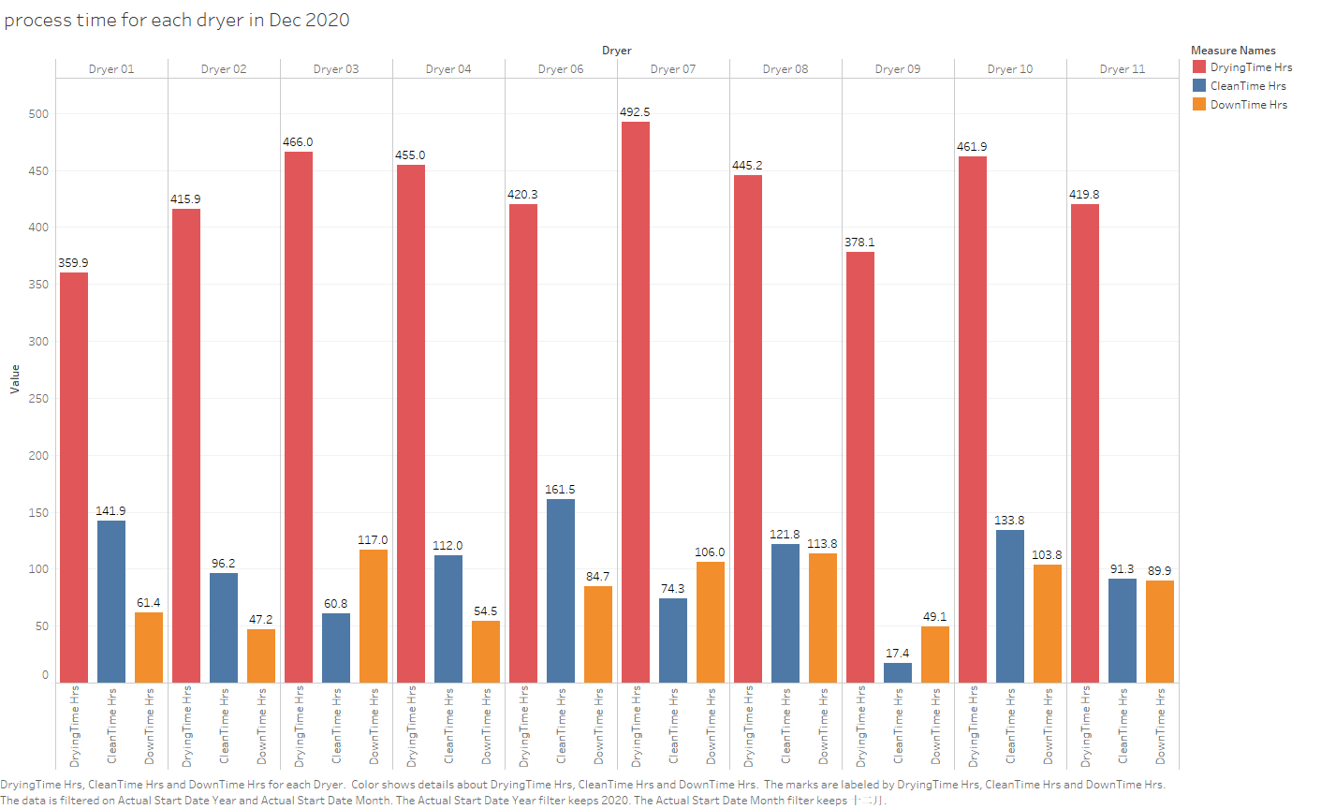

Slide 5
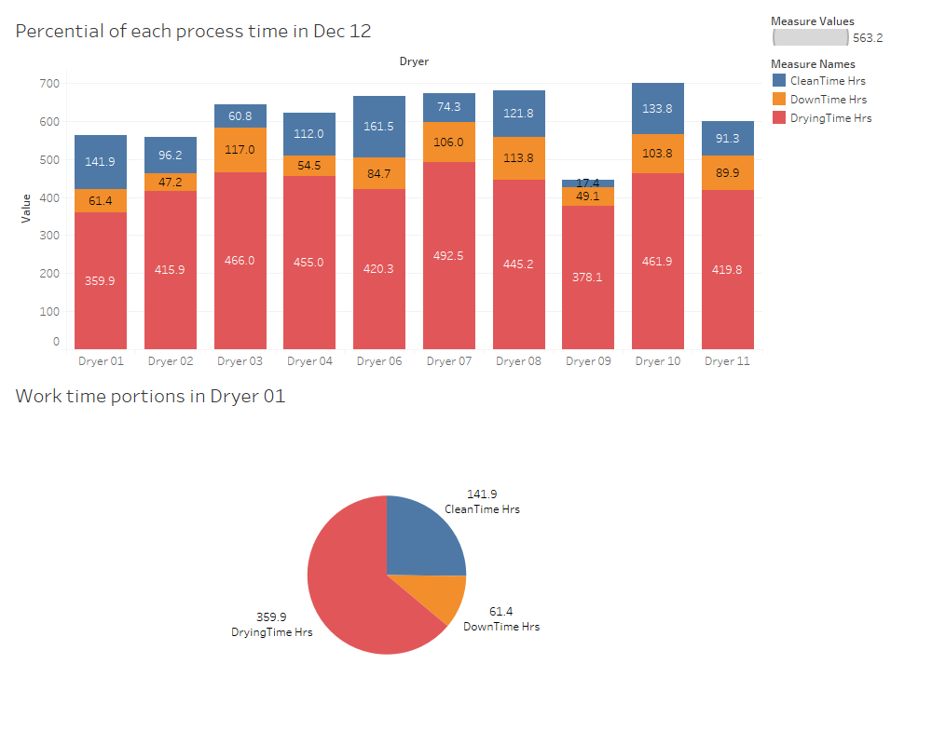
Year: 2020
Dryer 06 has the longest cleaning time than others
Dryer 03 has the longest down time than others
Year: 2020
Month: Dec
portion:
Drying time: 63.9%
Cleaning time: 25.2%
Down time: 10.9%

Slide 6
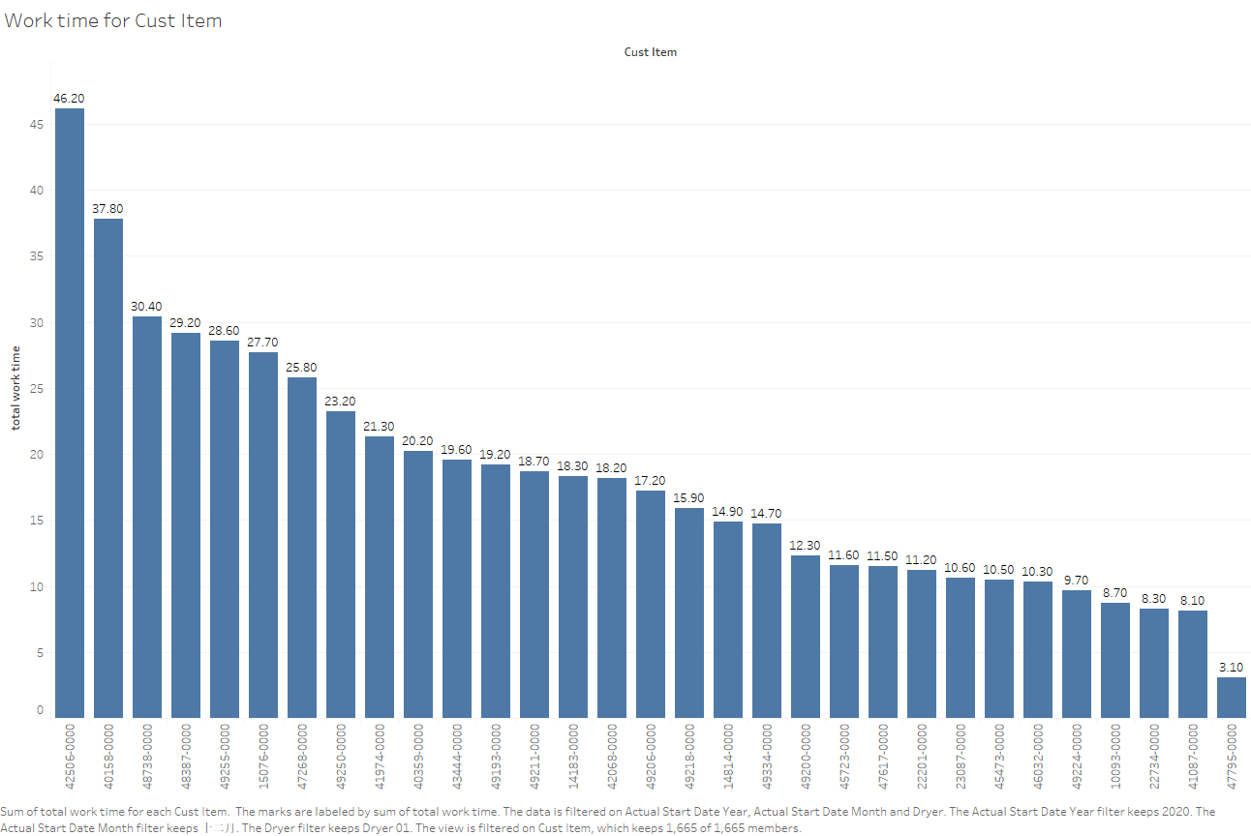
Year: 2020
Month: Dec
Dryer: 01
Unit: Hours

Slide 7
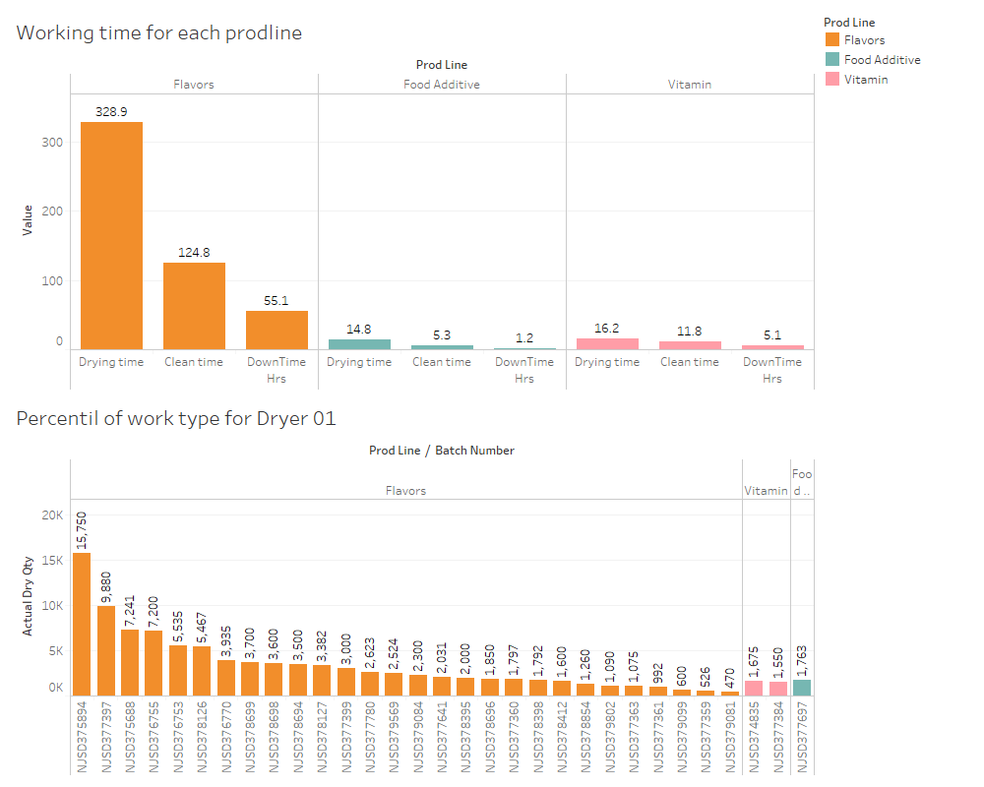
Year: 2020
Month: Dec
Dryer: 01
Unit: Hours
Work for Dryer01 concentrates on Flavors

Slide 8
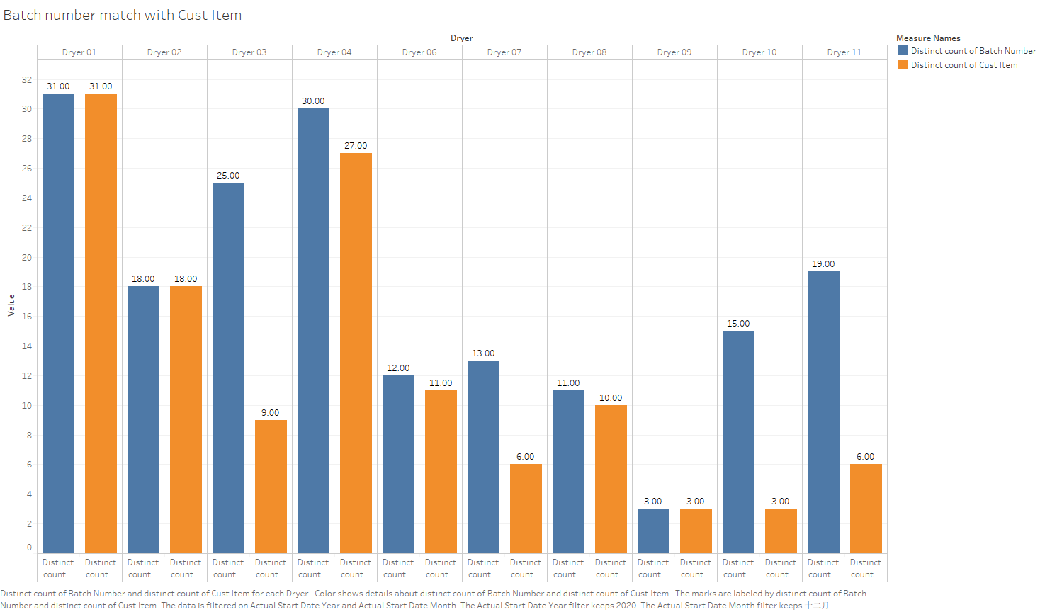

Slide 9
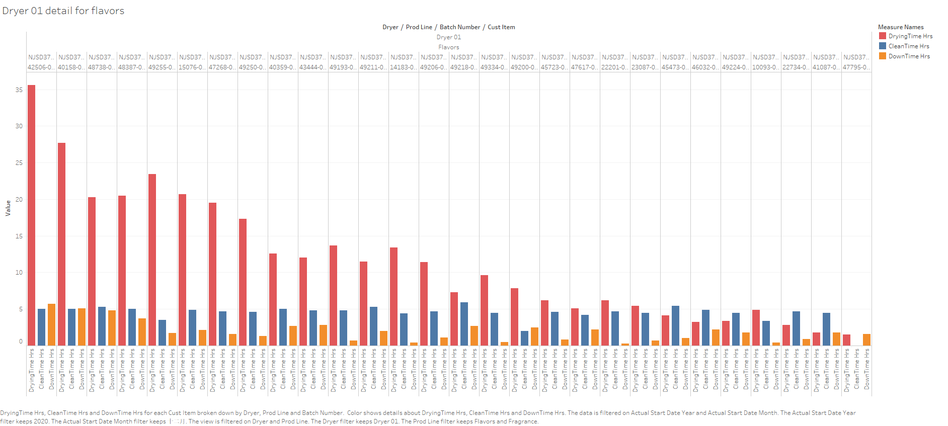

Slide 10
